Slide 1
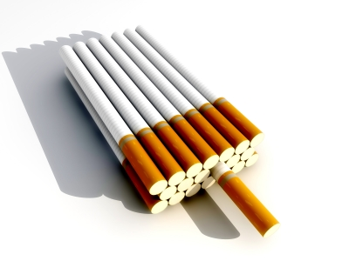
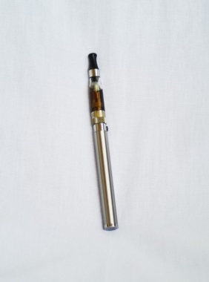
Tobacco Cessation

Slide 2
Modifiable Factors
Trainees who have the lowest levels of fitness on entry to the military are at greater risk of injury during basic training
Trainees who smoke cigarettes experience significantly more injuries than those who do not. This has been shown to be true for infantry as well.
MCI source: Chapter 6
Notes:
Smoking
Both female and male smokers who participate in Army or Marine Corps BT are at a significantly higher risk for injury than nonsmokers (20). Women who were smokers on entry into the Army were 25% more likely to be injured in BT.
The risk for injury among women in the Marine Corps who smoked before beginning BT was 1.7 times higher than for those who were nonsmokers (20). Male smokers in Army and Marine Corps BT were 1.9 times and 2.3 times more likely to have an injury, respectively, than their nonsmoking male counterparts (20,22).

Slide 3
Nicotine
Addictive agent in tobacco
Acts on the brain as a stimulant, depressant, or tranquilizer, depending on the dosage.
Physical and behavioral characteristics that determine tobacco addiction are similar to those that determine addiction to drugs such as heroin and cocaine.
Notes:
The addictive agent in tobacco is nicotine. Commonly used as an insecticide. Tobacco use allows for the absorption of 1-2 milligrams of nicotine per cigarette. Nicotine is only found in tobacco.
Nicotine can simultaneously act on the brain as a stimulant, depressant, or tranquilizer, depending on the dosage. The level of nicotine in the brain is crucial for heavy and highly dependent tobacco users, and he/she will unconsciously modify the tobacco amount until that intake level has been reached.
Dependent tobacco users need a brain level boost of nicotine about every 20-30 minutes throughout their waking hours in order to remain comfortable.
Much of the dependence-producing potency of nicotine is due to its almost instant absorption from the lungs following inhalation (cigarettes) or throughout the mucous membranes of the mouth for chewers, dippers, pipe smokers, or cigar smokers. Cigars will release nicotine into the mouth if simply kept there and not lit.

Slide 4
Nicotine
Chemical/Physical Addiction
Reaches brain in 7 seconds after you inhale and fools your brain into “feeling good”
Affects the chemistry of the brain and nervous system
Smokers may rely on cigarettes to regulate their moods
Increases heart rate
Increases blood pressure
Causes rapid, shallow breathing
Notes:
The overwhelming majority of people who smoke have a strong, physiological need for the nicotine contained in cigarettes and other tobacco products. This physiological need is referred to as nicotine dependence or nicotine addiction because it is nicotine that is responsible for the effects on the body.
Nicotine: reaches your brain seven seconds after you inhale and fools your brain into “feeling good”.
Affects the chemistry of the brain and nervous system. Smokers may rely on cigarettes to regulate their moods.
Increases heart rate.
Increases blood pressure.
Causes rapid, shallow breathing
Because nicotine has similar effects on the brain like heroin, cocaine, and marijuana, it is appropriate to consider nicotine an addictive drug. In order to break free from the dependence, participants must recognize that they have an addiction.

Slide 5
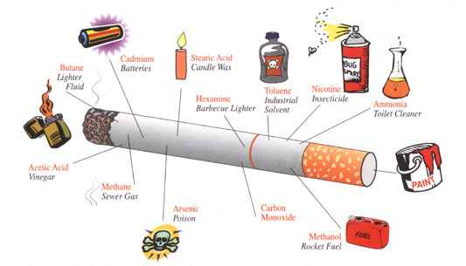
Would you drink these chemicals?
Notes:
There are over 7,000 chemicals in tobacco. Hundreds are toxic and about 70 are known to cause cancer.
Here are just a few…

Slide 6
Damage caused by smoking
COPD
Chronic Obstructive Pulmonary Disease
More than 21 million people in the US suffer from it
The 3rd leading cause of death
80-90% of COPD deaths are caused by smoking
There is no cure
Notes:
Chronic obstructive pulmonary disease
Chronic obstructive pulmonary disease (COPD) is a name for long-term lung disease which includes both chronic bronchitis and emphysema (discussed below). Here are some facts about COPD:
More than 12 million people in the United States suffer from COPD. Another 12 million may have the disease and not suspect it because they don’t know the early warning signs.
COPD is the third leading cause of death in the United States.
More women die from COPD than men.
Smoking is the main risk factor for COPD -- about 80-90% of COPD deaths are caused by smoking.
The longer and heavier a person smokes, the higher their COPD risk.
There’s no cure for COPD.
COPD most often starts unnoticed in young smokers, and usually gets far worse before it’s diagnosed. Noises in the chest (such as wheezing, rattling, or whistling), shortness of breath during activity, and coughing up mucus (phlegm) are some of the early signs of COPD.
Over time, COPD can make it hard to breathe even at rest. It limits activities and causes serious health problems. The late stage is one of the most miserable of all illnesses. It makes people gasp for breath and feel as if they are drowning.

Slide 7
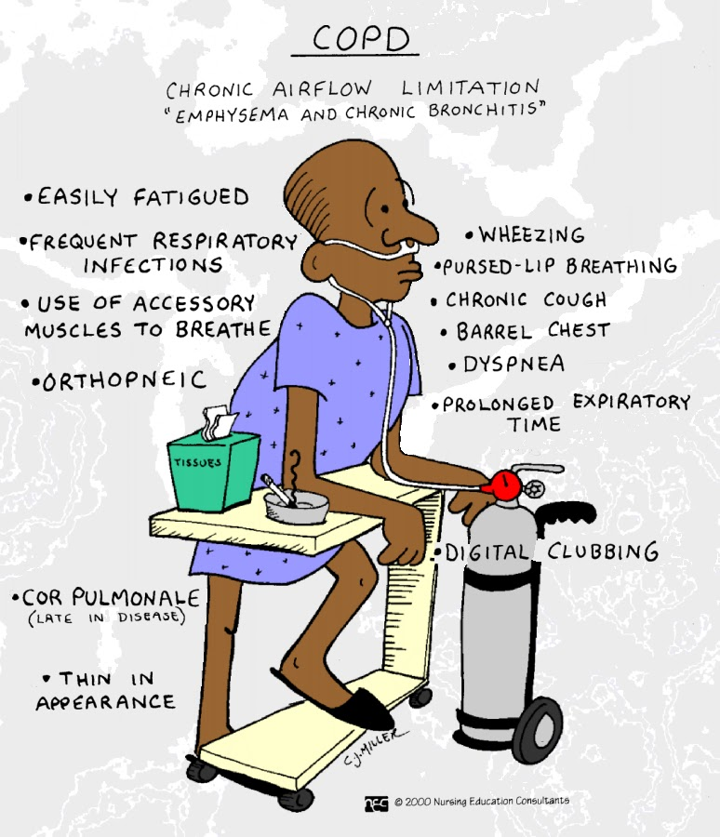
COPD Signs and Symptoms
Progressive Disease = Signs and symptoms may be mild at first and become more severe over time
Notes:
Since COPD is a progressive disease, many signs and symptoms may be mild at first and become more severe over time. Signs and symptoms of COPD may vary and include:
Shortness of breath or "dyspnea": when you breathe harder but feel like you're running out of air
Persistent (chronic) cough
Coughing up mucus/phlegm
Difficult or labored breathing during physical activity or while resting
Wheezing (air trying to flow through a narrow airway)
Higher frequency of pneumonia and lung infections

Slide 8
Damage caused by smoking
Chronic Bronchitis
Disease where the airways make too much mucus, causing the person to cough.
Symptoms can get better at times, but the cough keeps coming back.
No cure, but quitting can help control the symptoms.
Quitting smoking helps keep the damage from getting worse.
Notes:
Chronic bronchitis is a type of COPD, a disease where the airways make too much mucus, forcing the person to cough it out. It’s a common problem for smokers. The airways become inflamed (swollen) and the cough becomes chronic (long-lasting). The symptoms can get better at times, but the cough keeps coming back. Airways get blocked by scar tissue and mucus, which can lead to bad lung infections (pneumonia).
There’s no cure for chronic bronchitis, but quitting smoking can help keep symptoms under control. Quitting smoking also helps keep the damage from getting worse.

Slide 9
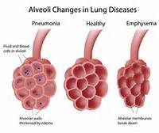
Damage caused by smoking
Emphysema
Slowly destroys a person’s ability to breathe
Notes:
Smoking is also the major cause of emphysema, the other type of COPD, which slowly destroys a person’s ability to breathe. Oxygen gets into the blood by moving across a large surface area in the lungs. Normally, thousands of tiny sacs make up this surface. In emphysema, the walls between the sacs break down and create larger but fewer sacs. This decreases the lung surface area, which lowers the amount of oxygen reaching the blood. Over time, the lung surface area can become so small that a person with emphysema must work very hard to get enough air, even when at rest.
Signs of late emphysema may include a cough that doesn’t go away (which is often dismissed as “smoker’s cough”), shortness of breath even when lying down, feeling tired, and weight loss. People with emphysema are at risk for many other problems linked to weak lung function, including pneumonia. In later stages of the disease, patients can only breathe comfortably with the help of an oxygen tube under the nose.
Emphysema cannot be cured or reversed, but it can be treated and slowed down if the person stops smoking.

Slide 11
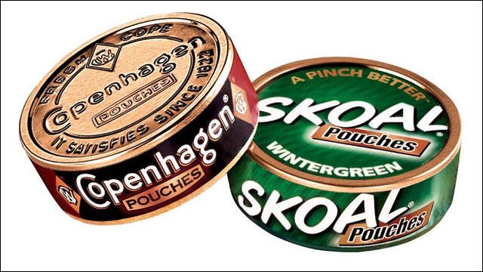
Smokeless Tobacco
One can of smokeless tobacco has the same nicotine as over 5 packs of cigarettes
The cancer causing chemicals in tobacco are 100x stronger than in cigarettes.
One can of smokeless tobacco contains a lethal dose of tobacco if a child or animal eats it.

Slide 12
Smokeless Tobacco
Over 50% of smokeless tobacco users develop pre-cancerous sores within 3 ½ years of use.
300,000 new cases of oral cancer in the US every year
Smokeless tobacco users are 5 times more likely to loose all their teeth, have receding gums and tooth decay due to tooth abrasion from sand and grit in the tobacco as well as the addition of sugar to the dip.

Slide 13
Health Consequences of Dip Use
Increased heart rate
Heart disease
Stroke
High blood pressure
Delayed wound healing
Peptic ulcer disease
Low birth weight babies and other reproductive disorders
Addiction and dependence

Slide 14
Check Your Mouth Often. Look closely at places where you hold the tobacco.
See your doctor or dentist right away if you have:
A sore that bleeds easily and doesn’t heal.
A lump or thickening anywhere in your mouth or neck.
Soreness or swelling that doesn’t go away.
White lump or patch in the mouth.
Prolonged sore throat.
Difficulty chewing.
Difficulty swallowing, feeling that something is stuck in the throat.
Difficulty moving the tongue or jaw.

Slide 15
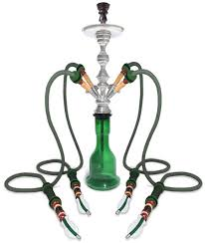
HOOKAH
Hookah smoke:
Contains high levels of toxic compounds including tar, carbon monoxide and heavy metals
Delivers about same amount of nicotine as cigarette smoking
Increases risk of spreading infectious diseases
An hour-long hookah session involves 200 puffs, while smoking an average cigarette involves 20 puffs.
Notes:
Similar to cigarettes, hookah smoking delivers the addictive drug nicotine and it is at least as toxic as cigarette smoking.
Hookahs are water pipes that are used to smoke specially made tobacco that is usually flavored. Hookah smoking is typically practiced in groups, with the same mouthpiece passed from person to person.
Using a hookah to smoke tobacco poses serious health risks to smokers and others exposed to the smoke from the hookah.

Slide 16
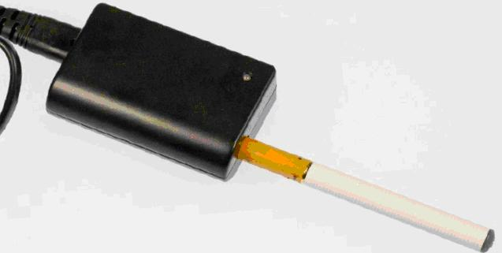
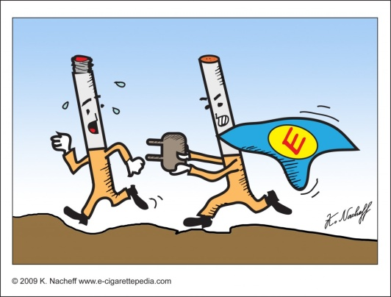
E- Cigarettes
FDA STATEMENT
E-cigarettes have not been fully studied so consumers currently do not know:
how much nicotine or other potentially harmful chemicals are being inhaled during use, or
if there are any benefits associated with using these products.
not known if e-cigarettes may lead young people to try other tobacco products, including conventional cigarettes, which are known to cause disease and lead to premature death.
Notes:
Electronic cigarettes, also known as e-cigarettes, are battery-operated products designed to deliver nicotine, flavor and other chemicals.
They turn chemicals, including highly addictive nicotine, into an aerosol that is inhaled by the user.
Most e-cigarettes are manufactured to look like conventional cigarettes, cigars, or pipes. Some resemble everyday items such as pens and USB memory s

Slide 17
E-Cigarette Contents:
Usually a combination of nicotine, flavorings, propylene glycol (a solvent) and other additives.
Some products contain nicotine amounts comparable to regular tobacco cigarettes, while others contain levels closer to that of a light cigarette.
There are also cartridges available that contain flavored liquid without nicotine.
Notes:
E-cigarettes are smoke-free and tobacco-free, but they're not nicotine-free. The liquid in e-cigarettes is typically a combination of nicotine, flavorings (such as bubble gum or watermelon), propylene glycol (a solvent), and other additives. The amount of nicotine depends on the mixture of the particular liquid-nicotine cartridge installed in the device. Some products contain nicotine amounts comparable to regular tobacco cigarettes, while others contain levels closer to that of a light or ultralight cigarette. There are also cartridges available that contain flavored liquid without nicotine, for users who want the sensory experience of smoking a cigarette without the harmful effects.

Slide 18
Liquid Nicotine
Liquid nicotine is extracted from tobacco, but unlike tobacco leaves it can be lethal
Less than 1 Tbsp of many e-liquids is enough to kill an adult if ingested or absorbed in your skin.
The number of calls to poison control centers regarding e-cigarettes has increased 41.7% from 2010 to 2014
*Some testing suggests it’s not only the nicotine that may be dangerous. Certain e-cigarette devices may also release metals during use, such as tin.
Notes:
Cigarette smoke contains more than 7,000 chemicals, and among those, 69 are known carcinogens [source: American Lung Association]. But it's not only regular cigarettes that are toxic to our bodies; e-cigarettes, too, come with health and safety concerns. The problem? Liquid nicotine.
Liquid nicotine is extracted from tobacco, but unlike tobacco leaves, liquid nicotine can be lethal. It can cause harm when it's inhaled, but it can also be harmful when ingested or absorbed through your skin. Only a small dose is dangerous -- less than one tablespoon of many of the e-liquids on the market is enough to kill an adult, and as little as a teaspoon could kill a child) [source: Richtel]. The number of calls to poison control centers regarding e-cigarette nicotine-infused liquids rose sharply every month between September 2010 and February 2014, from just one call per month to as many as 215 -- that's a rise from 0.3 percent to 41.7 percent of all emergency calls. As many as 51.1 percent of those calls involved accidental poisoning of kids under the age of 5 (roughly 42 percent involved adults age 20 or older) [source: CDC].
Some testing suggests it's not only the nicotine that may be dangerous. Certain e-cigarette devices may also release metals during use -- including tin in some cases -- as well as other impurities known to be toxic and/or carcinogenic.

Slide 19
E Cigarettes: Lack of Disclosure
The safety of e-cigarettes is still unknown.
We are not sure of the ingredients used in these products.
The amount of nicotine listed on a cartridge label may not match the actual amount in the cartridge.
Lab tests indicate there is still a low dose of nicotine in “nicotine-free” cartridges.
Notes:
Despite being on the market for several years, many regulatory agencies and health experts aren't sure just how safe e-cigarettes actually are. Among their concerns is the lack of disclosure of all the ingredients used as well as the lack of (or validity of) health and safety claims by manufacturers about their products. In 2009, for example, the Food and Drug Administration (FDA) found some cartridges of liquid nicotine contained about 1 percent diethylene glycol (DEG), a toxic chemical ingredient also found in antifreeze [source: FDA].
To make matters worse, the amount of nicotine listed on a cartridge label may not match the actual amount in the cartridge. FDA testing has found cartridges under the same manufacturing label may release significantly different levels of nicotine, ranging from 26.8 to 43.2 micrograms nicotine per 100 milliliter puff. And those nicotine-free cartridges? Lab tests indicate you're still getting a low dose, despite the claims [source: FDA].

Slide 20
Brought to you by:
Ms. Lauren King, MS, RD, CSSD
Semper Fit Dietitian and Health Promotion Coordinator
MCB Quantico, VA
Ms. Lisa Vice
Semper Fit Assistant Fitness Director
MCB Quantico, VA

